Slide 1
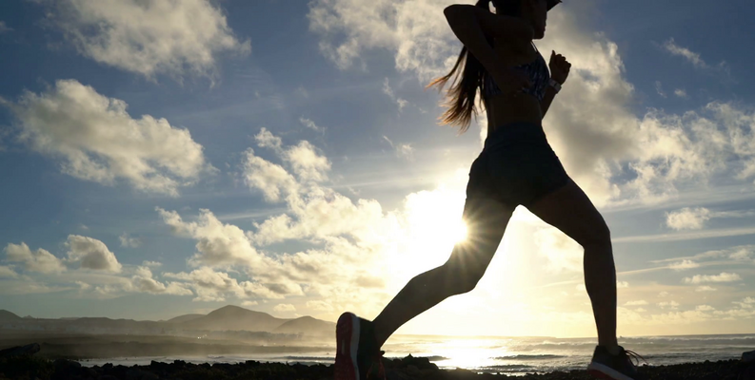
Case Study: Bellabeat
Created by : Sneha Pasalkar
Last update: 03/09/2023

Slide 2

Table of content
Client Introduction
Meet stakeholders
Understanding client requirements
Business task
Understanding data
Preparing and Performing Analysis
Sharing Analysis
Actionable Findings
Key takeaways
References used
Questions

Slide 3
Client Introduction
Bellabeat, a high-tech manufacturer of health-focused products for women
Bellabeat is a successful small company, but they have the potential to become a larger player in the global market
Services offered by bellabeat are:
Bellabeat Application
Leaf
Time
Membership
Spring

Slide 4
Meet Stakeholders
Urška Sršen
Bellabeat marketing analytics team
Sando Mur
Mathematician and bellabeat’s cofounder; key member of the Bellabeat executive team
A team of data analysts that helps guide Bellabeat’s marketing strategy
Bellabeat’s cofounder and Chief Creative Officer

Slide 5
Client Requirements
Fonder wants to analyze smart device fitness data to help unlock new growth opportunities for the company
Focus on the services offered by the client and help them improve their marketing strategy based on data
Will be focusing on below key questions to solve this case study:
What are some trends in smart device usage?
How could these trends apply to Bellabeat customers?
How could these trends help influence Bellabeat marketing strategy?

Slide 6
Business Task
Understand and analyze overall smart devices usage of Bellabeat to gain insights how people and using it and what client can do to improve their services by identifying market trends which can help them build strong marketing strategy and opportunities of growth

Slide 7
Understanding data
Client has shared : FitBit Fitness Tracker Data (CC0: Public Domain, dataset made available through Mobius)
This dataset generated by respondents to a distributed survey via Amazon Mechanical Turk between 03.12.2016-05.12.2016.
Dataset is open source
Data set contains personal fitness tracker from thirty fitbit users. Thirty eligible Fitbit users consented to the submission of personal tracker data, including minute-level output for physical activity, heart rate, and sleep monitoring. It includes information about daily activity, steps, and heart rate that can be used to explore users’ habits

Slide 8
Understanding data : Issues it have
Due to the limitation of size (30 users) and not having any demographic information we could encounter a sampling bias. We are not sure if the sample is representative of the population as a whole. Another problem we would encounter is that the dataset is not current and also the time limitation of the survey (2 months long). That is why we will give our case study an operational approach
ROCCC Analysis:
Reliability : Medium: As we know the source (Survey)
Original: Low: As it is third party data
Comprehensive: Medium: Shows diverse fields
Current: Low: Old data
Cited: Low: As collected by third party

Slide 9
Preparing and Processing Data for analysis
Here, We have used Rstudio as our IDE and we have prepared R markdown document to show our analysis steps
We have created a folder called project, which include
Csv files used shared by client
R Markdown Documents
Images we have used
Visualizations we have created

Slide 10
Preparing for Analysis
We started with installing required packages and libraries
Packages include:
tidyverse
readr
janitor
Skimr
Libraries include:
tidyverse
readr
ggplot
dplyr
Lubridate
Tidyr
Janitor
skimr

Slide 11
Loaded required .csv files using read_csv()
Checked loaded files using
head(): Initial few rows are checked
str(): Summary of data frame
colnames(): Gives names of columns within data frame.

Slide 12
Cleaning phase of data
Change column names using rename()
Changed data type of column using mdy() and hms()
Clean column names using clean_names()
Separated column as two different columns using separate()
Checked unique values of data frame using n_distinct()
Checked if any data frame has duplicate values using duplicated()
Dropped duplicated values using drop_na()
Note: Please refer to Rmarkdown document for detailed steps

Slide 13
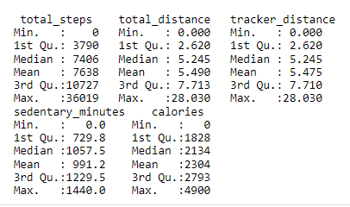
Analysis Phase of data
Above data shows average steps taken by individual is 7406, which is quite low, as per research average steps for a healthy adult shoud be 10000.
Based on this we can suggest bellabeat to make strategy to motivate users for 10000 steps
Client can start showing reminder to complete 10000 steps
Data shows on an average user covers a distance of 5 km which is good sign
Client can opt in for special customized alerts based on users previous data, if user is walking for 5 km per day generally, app should notify them if it is not done on specific day.

Slide 14
The data also shows sedentary minutes average as 1057.5, which is too much and which is not good if being active is the goal of user.
In this case there are three scenarios:*
When user is inactive due to working style (working on system) then it may capture that time as sedentary as movement is less.
When user is asleep for some time
When user is travelling.
As we have limited data for user and we do not have much details as when this sedentary time was captured we can not reach out to root cause of this, however bellabeat can start having notifications if idle time is more than an hour to encourage physical activity
Sending notifications for idle time and allowing user to snooze it or to set it for customized time can be done.
Our data shows average calories burned are 2134. According to the Dietary Guidelines for Americans 2020–2025, the average adult woman burns roughly 1,600 to 2,400 calories per day so our data matches with the expectations.
Bellabeat can use sending notifications here too to motivate users to progress on a fitness path

Slide 15
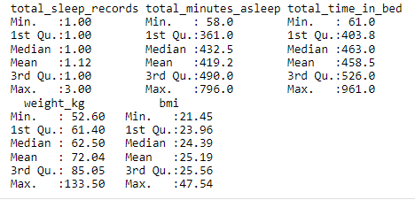
Analysis Continued…
Based on above observations we can conclude:
Users are mostly active for 4 minutes only
Users are fairly active for 6 minutes only
Mostly users are lightly active
Average user sleeps for 7 hours
Average time in bed is also around 7.64 hours

Slide 16
Here our data has some limitations as we don't know sleep category, there are some apps which shows subcategory in sleep as deep sleep, light sleep
bellabeat can use such subcategory to provide more customized user experience
bellabeat can work on creating a function which allows user to schedule sleep routine
bellabeat can also work on sending notifications when sleep routine is about to start, so that user can work on their sleeping patterns as well, because study shows that 8 hours of sleep is required for a healthy life
Data shows average weight of user is 62.5 KG
Average BMI of user is 25.19, this is not good as BMI > 24.9 is considered as obese
bellabeat can work on suggesting low calorie diets or recipes which user can refer to reduce weight.

Slide 17
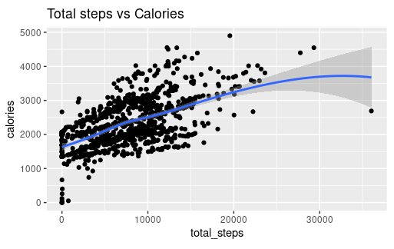
Visualizations to support our analysis
This plot shows positive correlation between total steps and calories burned.
Based on this we can suggest bellabeat to make strategy to motivate users for 10000 steps
Client can start showing reminder to complete 10000 steps

Slide 18
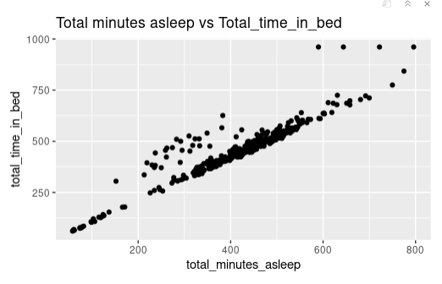
Based on this plot we can see positive correlation between total time in bed with total minutes asleep
bellabeat can work on creating a function which allows user to schedule sleep routine
bellabeat can also work on sending notifications when sleep routine is about to start, so that user can work on their sleeping patterns as well, because study shows that 8 hours of sleep is required for a healthy life

Slide 19
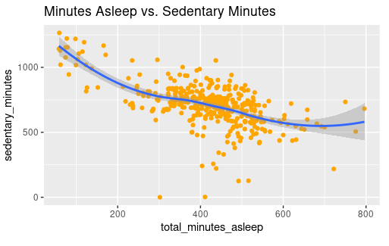
This plot shows there is negative correlation between sedentary_minutes and total minutes asleep
This shows if bellabeat users want to improve their sleep they should reduce sedentary minutes.
Sending notifications for idle time and allowing user to snooze it or to set it for customized time can be done

Slide 20
Tools and references used
Rstudio IDE
Rmarkdown
Microsoft powerpoint
Kaggle website
Google search engine for research

Slide 21
Any Questions
Thank you!

